Slide 1
Todo list
(How it works?)

Slide 2
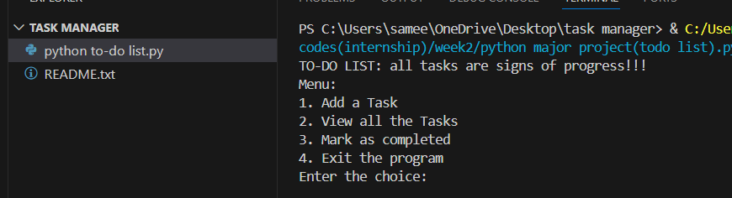
Menu

Slide 3
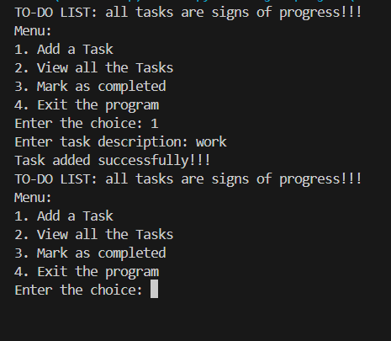
1)Add a task
The user can easily add the task to the “to-do”
And it will take care of it
Add the task to the list.

Slide 4
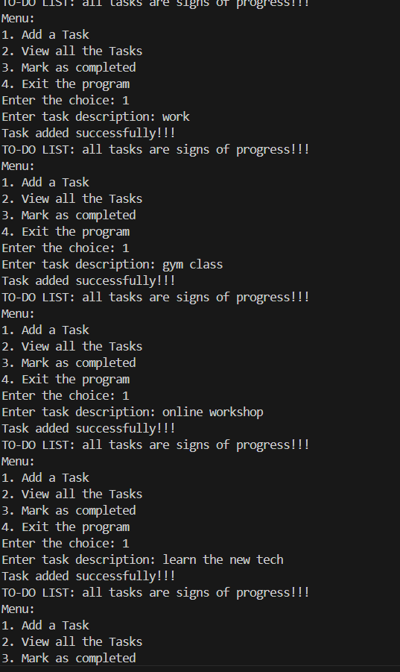
Tasks added to the list.
Continuous tasks were added and the to-do can efficiently take it.

Slide 5
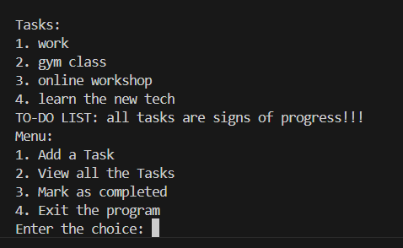
2)View all tasks
The list can be seen by the user very easily by just tapping on “view all tasks”

Slide 6
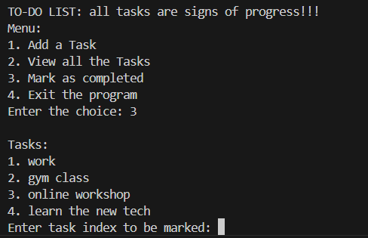
3)Mark as completed
As it is a to-do list , the tasks are to be completed and once they are completed they are no longer in use to the task list
So “mark as completed” can be used to strike the task once its completed.

Slide 7
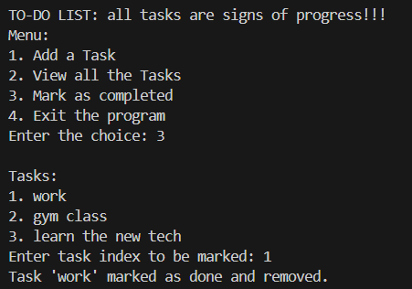
Task strike
The task is being removed because its accomplished.

Slide 8
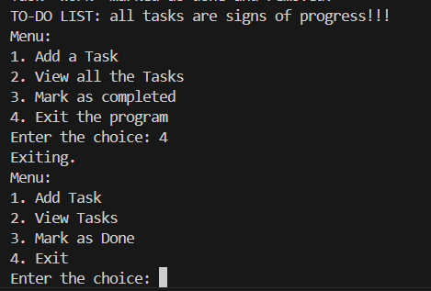
4)Exit
If the user wants to exit they can easily tap on exit
And the user can stop the listing once they are done.

Slide 9
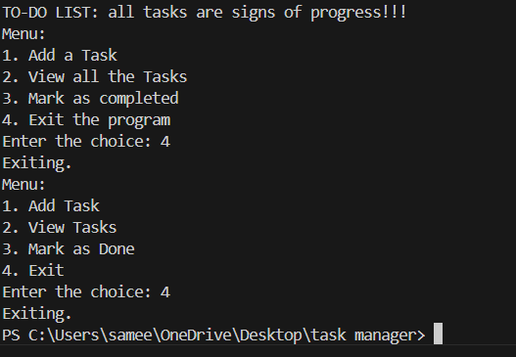
Final exit
The End of the to-do list
All caught up.
Thank you!!!

